Slide 1
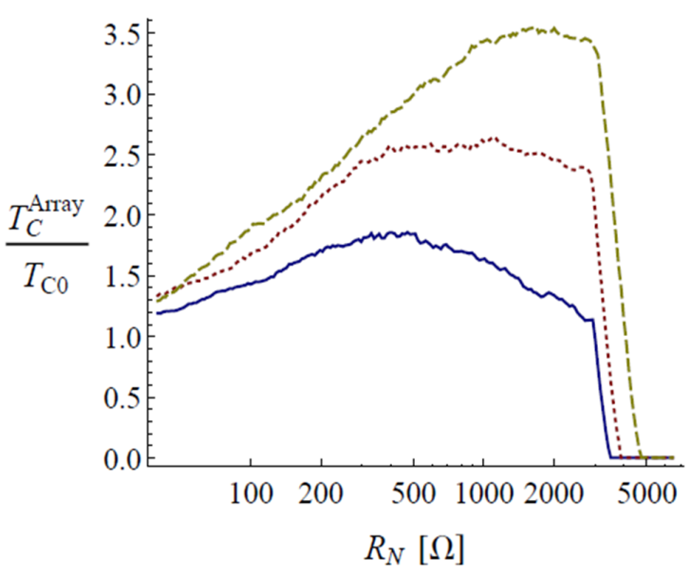
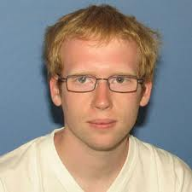
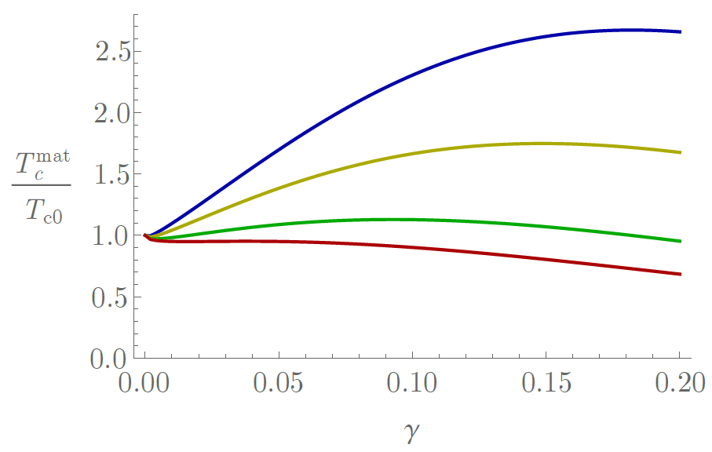

Can inhomogeneities enhance superconductivity?
Antonio M. García-García
Cavendish Laboratory, Cambridge University
Global critical temperature in inhomogeneous superconductors induced by multifractality
arxiv:1412.0029 Phys. Rev. B, In Press
Strong enhancement of bulk superconductivity by engineered nanogranularity
Phys. Rev. B 90, 134513 (2014)
James Mayoh

Slide 2


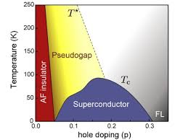
Superconductivity For Happiness
Trial and error
Mavericks
Quantum critical points ©
Cuprates ~100K 1986 Mueller & Bednorz
MgB₂ 39K 2001 Akimitsu
FeSC ~50K 2006 Hotsono

Slide 3
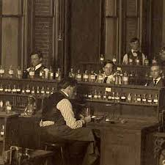
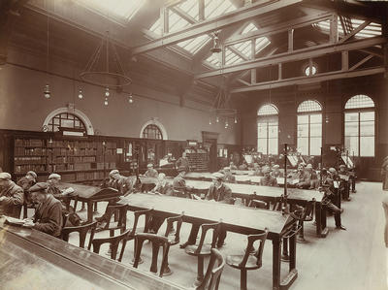
Pb ~7K Al ~1K Sn ~3.7K Nb ~9.3K
Librarians
Thinner
Cleaner
Smaller
DFT
BCS + (weak) disorder, interactions..
Thin films
Josephson Junctions
Control
Nanowires

Slide 4
Mavericks meet Librarians
A revolution is going on
Experimental Control
Theory does not drift
True Design of Materials!
Boring+Boring = Interesting
Enhancement T_{c}?
Conventional SC in low dimensions
Artificial hetero,nano-structures
Novel Interfaces FeSe/STO, LAO/STO

Slide 5
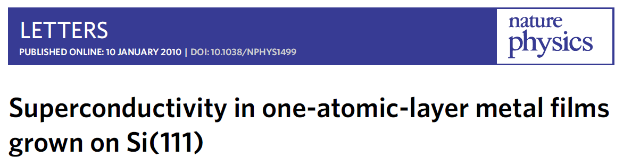
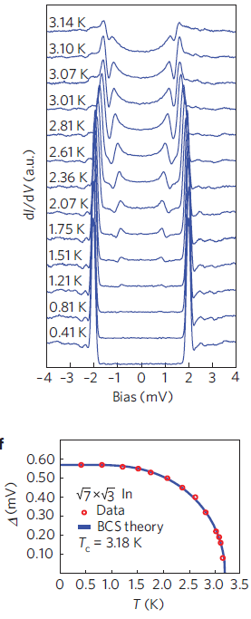
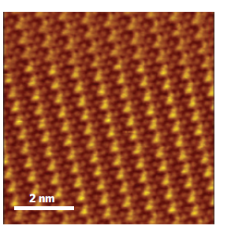
Epitaxial growth
STM
Impurities?

Slide 6
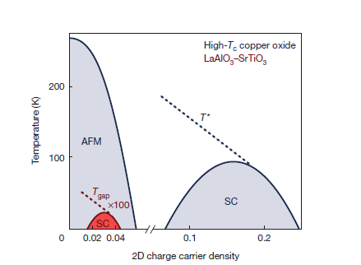
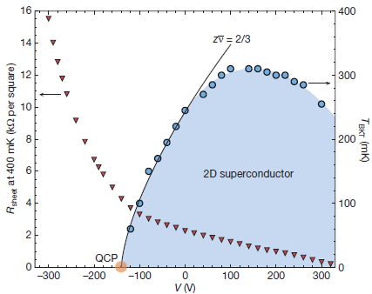
LaAlO₃ /SrTiO₃ interface
Triscone et al. , Nature 456 624 (2008)
Mannhart et al., Nature 502, 528 (2013)
Control
Electric Field Effect
Tunability
No chemical doping

Slide 7
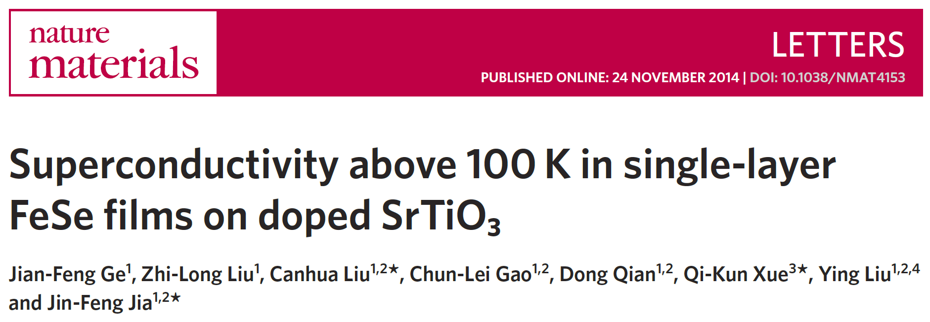
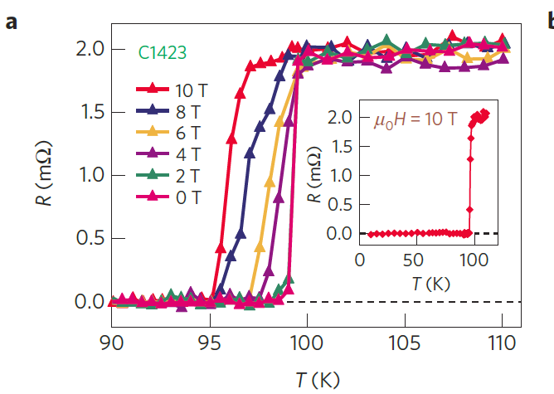
Bulk FeSe
8K!

Slide 8
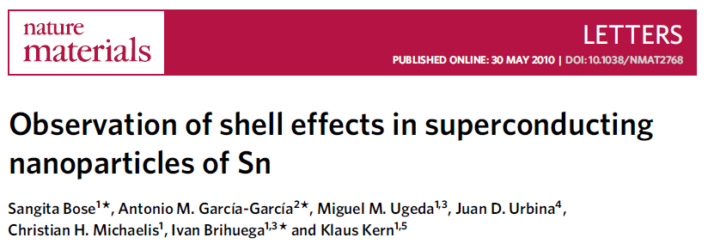
7 nm
0 nm
Tinkham 80’s single but not isolated

Slide 9
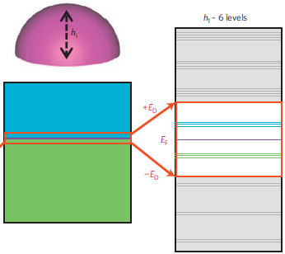
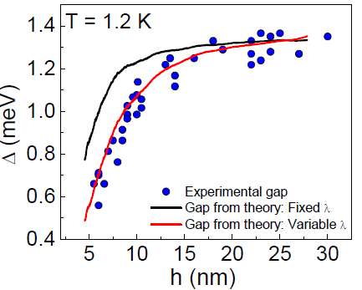
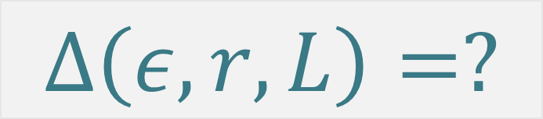
Δ >> δ
L ~ 10nm
BCS+ Path integral
Quantum chaos
$$Δ\left(ε,r,L\right)=?$$
Parmenter, Blatt, Bianconi, Thompson, Perali, Croitoru, Shanenko
P. Ribeiro, AGG, PRL. 108, 097004 (2012)
Mayoh, AGG, PRB 90, 014509 (2014)
Ribeiro, AGG, PRB 89, 064513 (2014)
AGG, Altshuler, et al. PRB 83, 014510 (2011)
Brihuega, AGG, Phys. Rev. B 84, 104525 (2011) Editor’s choice
AGG, Altshuler, et al. PRL 100, 187001 (2008)

Slide 10




Δ >> δ
L ~ 10nm
BdG is difficult
Expansion in 1/k_{F}L, δ/∆₀
Parmenter, Blatt, Bianconi, Thompson, Perali, Croitoru, Shanenko
AGG, Altshuler, PRL 100, 187001 (2008) AGG, Altshuler, PRB 83, 014510 (2011)

Slide 11
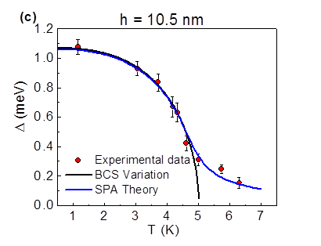
Quantum Fluctuations
Richardson’s equations
and
Thermal Fluctuations
Static Path Approach
PRB 84,104525 (2011)
Editor‘s Suggestion

Slide 12
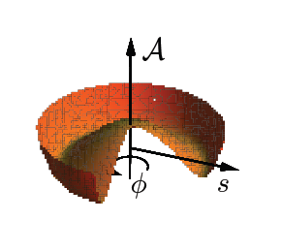
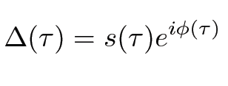
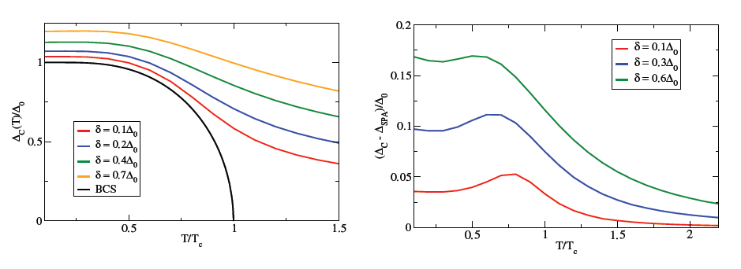
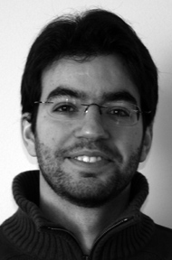
Quantum + Thermal?
T, δ/ Δ₀ << 1
Divergences at intermediate T
Rossignoli and Canosa
Ann. of Phys. 275, 1, (1999)
Harmful Zero Modes
Polar coordinates
Castellani, et al. PRL 78, 1612 (1997)
Quantum fluctuations ~ Charging effects
Ribeiro
Ribeiro and AGG, Phys. Rev. Lett. 108, 097004 (2012)

Slide 13
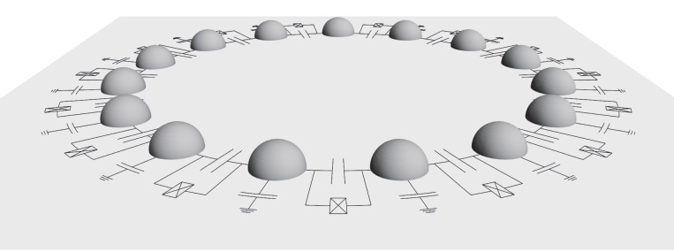
1D JJ array T=0
Capacitance+fluctuations+quasiparticles
Homogeneous Amplitude
C=0, Superconductivity at T=0 for L > L_{c}
Fluctuations sometimes good for SC
P. Ribeiro, AGG, PRB 89, 064513 (2014)

Slide 14
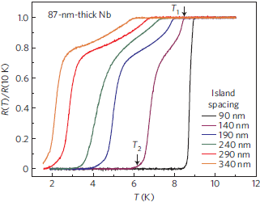
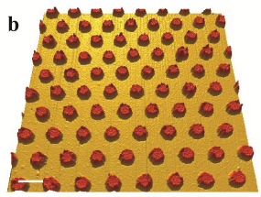
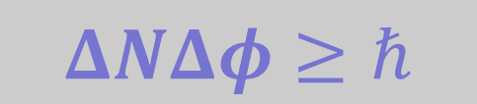
True phase coherence in single nanograins?
No
$$ΔNΔφ≥ℏ$$
Josephson
array?
Maybe
Mason, et al, Nature Physics 8 59 (2012)

Slide 15
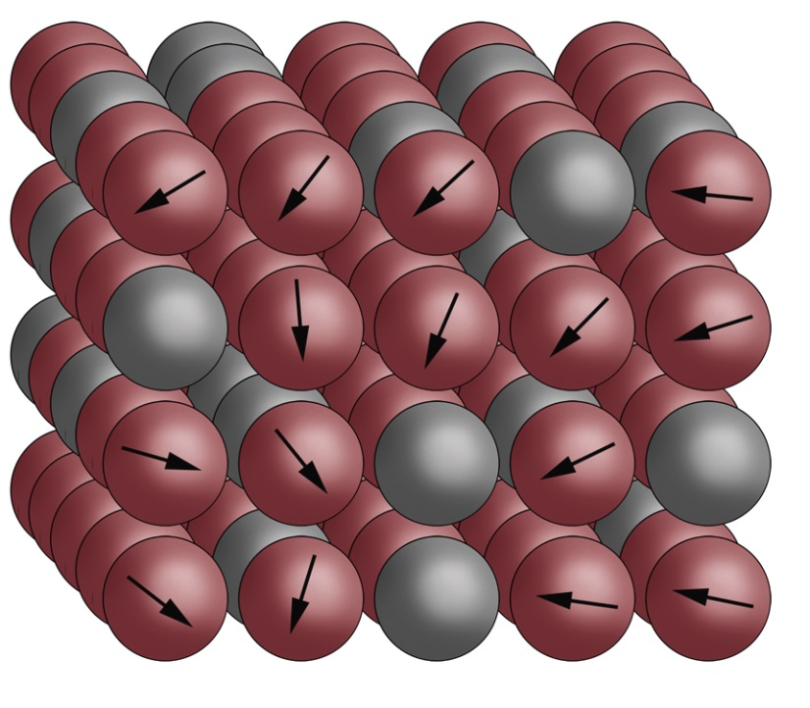
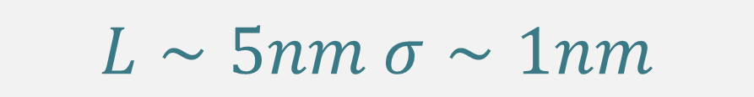
Engineering inhomogeneous materials
James Mayoh
Inhomogeneous JJ arrays
Experimentally feasible
$$L∼5nm σ∼1nm$$
3D nano-spheres
Charging effects
Global T_{c} > Bulk T_{c}?
Nano-granularity Mayoh, AGG. PRB 90, 134513 (2014)

Slide 16

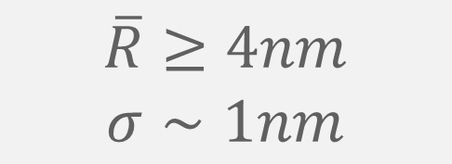
Designing JJ arrays:
Realistic, doable, optimal
3D
Nano spheres
Packing?
Clean
NO BKT
Quasi particle tunnelling
$$\overline{R}≥4nm$$
$$σ∼1nm$$
YES BCS
Charging
Deutscher 73’

Slide 17
Grey = No SC
Global T_{c} ?
L ~ 5nm
Highly inhomogenous
T
Grain T_{c} sensitive to L
Fine not all grains SC

Slide 18
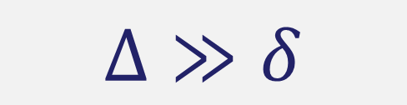
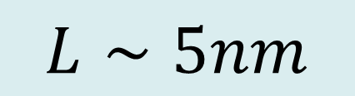
How?
$$Δ≫δ$$
$$L∼5nm$$
BCS
Single grain
$$\frac{1}{k_{F}L}≪1$$
Periodic orbit theory
Balian,Bloch,Gutzwiller
Tunneling
Open grain
Cutoff long periodic orbits

Slide 19




Single grain
Tunneling
Smooth DOS
Open grain
Weaker size effects

Slide 20

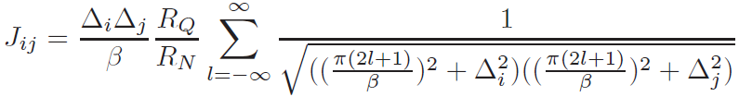
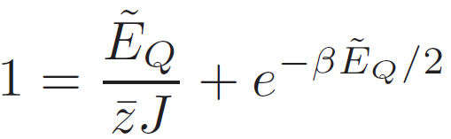




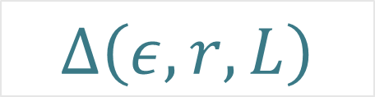
1 Nano-Grain
$$Δ\left(ε,r,L\right)$$
+
Tunnelling
I
N
H
O
M
O
G
E
N
E
O
U
S
3D Array
Schoen, Zaikin, Fazio
Charging
Hopping
Quasiparticles
H
O
M
O
G
E
N
E
O
U
S
T
#SCG
Percolation ?

Slide 21
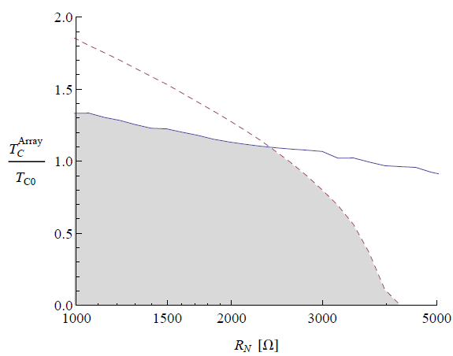
Percolation?
Phase fluctuations?
T
#SCgrains
T_{c}?
R=5nm σ=1nm λ=0.3

Slide 22
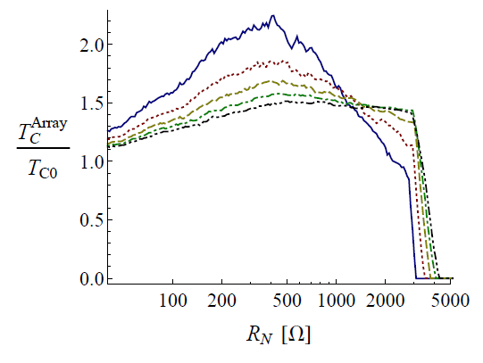



$$λ=0.2, 0.25, 0.3, 0.35$$
$$σ=1 nm$$
$$\overline{R}=5 nm$$

Slide 23
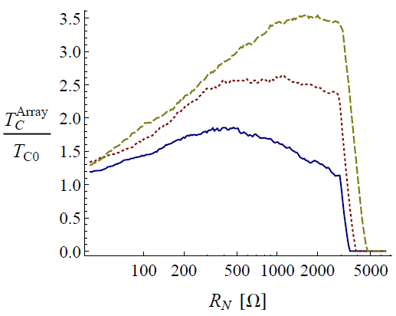


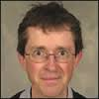



Packing = FCC, BCC, Cubic
$$σ=1 nm$$
$$\overline{R}=5 nm$$
$$λ=0.25$$
Enhancement!
Patent
Mark Blamire
Cambridge

Slide 24
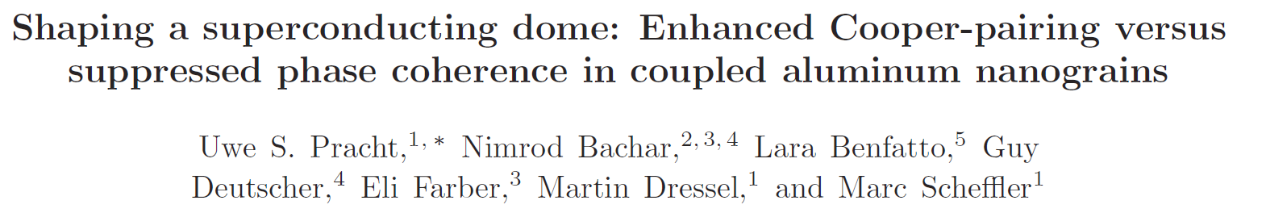
SURPRISE!

Slide 25
Disorder and enhancement of superconductivity?

Slide 26
Can it be true?
Trivedi, Meir…..
Pratap, Sacepe…..
Numerics
Experiments
Strong coupling and disorder
Strong disorder and no weak coupling
AGG,Tezuka, 2011
Abeles,… 60’s
Gor'kov and Abrikosov
Finkelstein A M, 1987
Anderson theorem
Weak localization
Anderson, J. Phys. Chem. Solids 11, 26 (1959)
Maekawa S, Fukuyama H, 1982
Anderson theorem is all but a theorem
Be careful with BCS+Perturbation

Slide 27
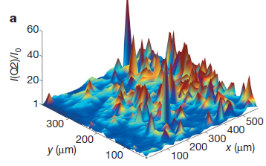
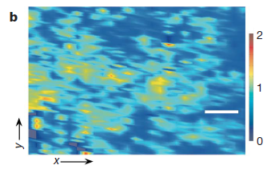
Enhancement of Tc by disorder
Fractal distributions of dopants enhance Tc in cuprates
Bianconi, et al., Nature 466, 841 (2010)
Inhomogeneities
Higher T_{c}
PRL 108, 017002 (2012)
PRL, 98, 027001 (2007)

Slide 28
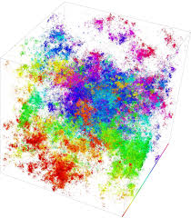
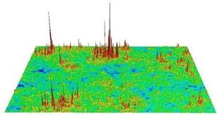
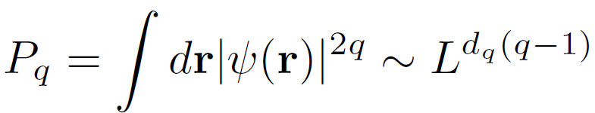
Anderson Metal-Insulator Transitions
Multifractal eigenstates
Wegner, Aoki, Castellani, Efetov

Slide 29
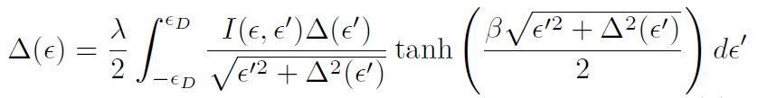
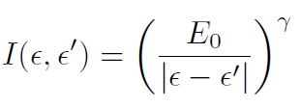







Strong multifractality and superconductivity
Feigelman, Ioffe, Kravtsov, Yuzbashyan, Phys. Rev. Lett. 98, 027001 (2007)
I. S. Burmistrov, I. V. Gornyi, A. D. Mirlin, Phys. Rev. Lett. 108, 017002 (2012)
$$ε_{D}→∞$$
?
$$ε=ε_{F}$$
$$γ∼0.4$$
~ 0.4
$$T_{c}≥1000K$$

Slide 30
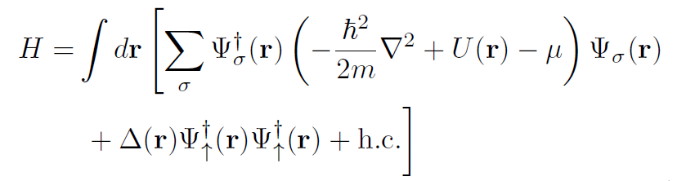
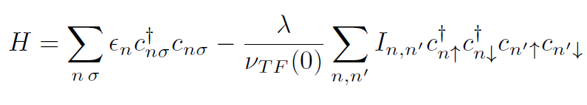

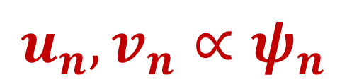
Some bad news
BdG too difficult
BCS doable
$$u_{n},v_{n}∝ψ_{n}$$
but valid only if

Slide 31


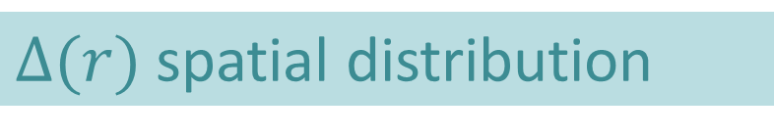




Weak multifractality and superconductivity
J. Mayoh and AGG, arxiv:1412.0029
Where?
What?
(Ultra) Thin films
$Δ(ε_{F})$ energy gap
2D + Spin orbit
$Δ\left(ε\right)$ energy dependence
1D + Long Range
$Δ(r)$ spatial distribution
How?
Global T_{c}
$$λ,γ≪1$$
$$BCS,ε_{D }fixed$$
Can disorder enhance SC?
Percolation

Slide 32







$$Δ\left(ε_{F}\right)=Δ_{γ}$$
$$Fixed λ$$
$$Fixed ε_{D}/E_{0}$$
Still unrealistic
Why?
Not true Tc
Inhomogenous SC

Slide 33



Energy dependence of $Δ(ε)$

Slide 34







Spatial Distribution
Eq.137, Feigelman M V, Ioffe L B, Kravtsov V E, Cuevas E, 2010 Ann. Phys. 325 1368
$$κ∼1/g$$
Universal log-normal distribution!

Slide 35





$$γ∼1/g$$
Global Tc?
Sacepe et al., Nat. Phys. 7 239 (2011)
Lemarie, Benfatto, et al., PRB 87, 184509 (2013)
Tracy-Widom?

Slide 36




Global Tc
Percolation
$$λ=0.25,0.3,0.4,0.5$$

Slide 37





Phase fluctuations?
$$λ=0.25$$
$$φ>φ_{c}$$
$$φ_{c}=0.675,0.7,0.75,0.8$$
Enhancement?
$$λ≤0.3$$
Yes
But
Al is fine!

Slide 38
Experimental tests
STM in thin films log² distribution
Disorder
Transport to test higher global Tc
Nano engineering
L ~ 5-10nm?
Conclusion
FeSe?
Enhancement?
Only in boring materials?
Sure
MgB₂?

Slide 39


Engineering FeSe/STO
Interface design
Nano-granularity
Xue
Tsinghua
Xue et.al PRB B91 060509(R) (2015)

Slide 40
THANKS!

