Slide 1
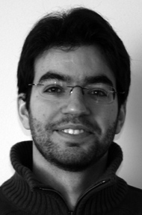

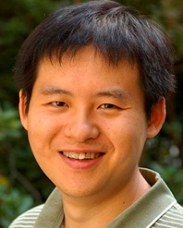
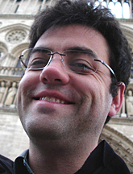
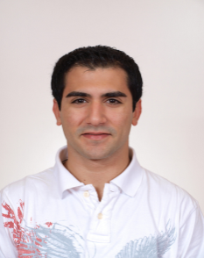
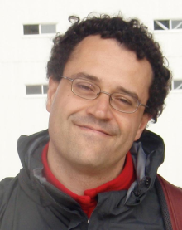
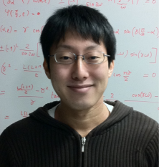
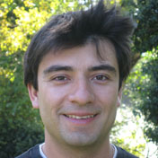
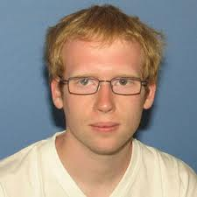


Smaller is different and more: Low dimensional superconductivity for new physics and applications
Antonio M. García-García
Cavendish Laboratory, Cambridge University
Tezuka
Kyoto
Hong Liu
MIT
Paul Chesler Harvard
Bermudez
Cambridge
Pedro Ribeiro Lisbon
Naidon RIKEN
Cazalilla Tsinghua
Endo Paris, ENS
Lobos Maryland
Mayoh
Cambridge

Slide 2

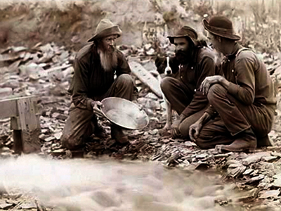
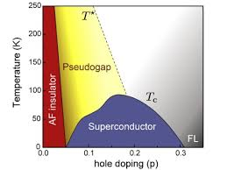
Superconductivity For Happiness
Trial and error
Mavericks
Quantum critical points ©
Cuprates ~100K 1986 Mueller & Bednorz
MgB₂ 39K 2001 Akimitsu
FeSC ~50K 2006 Hotsono

Slide 3
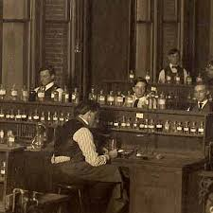
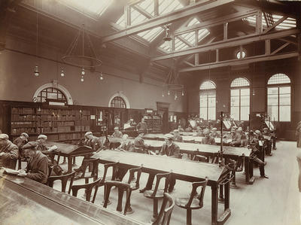
Pb ~7K Al ~1K Sn ~3.7K Nb ~9.3K
Librarians
Thinner
Cleaner
Smaller
DFT
BCS + (weak) disorder, interactions..
Thin films
Josephson Junctions
Control
Nanowires

Slide 4
Mavericks meet Librarians
A revolution is going on
Experimental Control
Theory does not drift
True Design of Materials!
Enhancement of superconductivity?
Conventional SC in low dimensions
Artificial hetero,nano-structures
Novel Interfaces FeSe/STO, LAO/STO

Slide 5
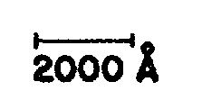
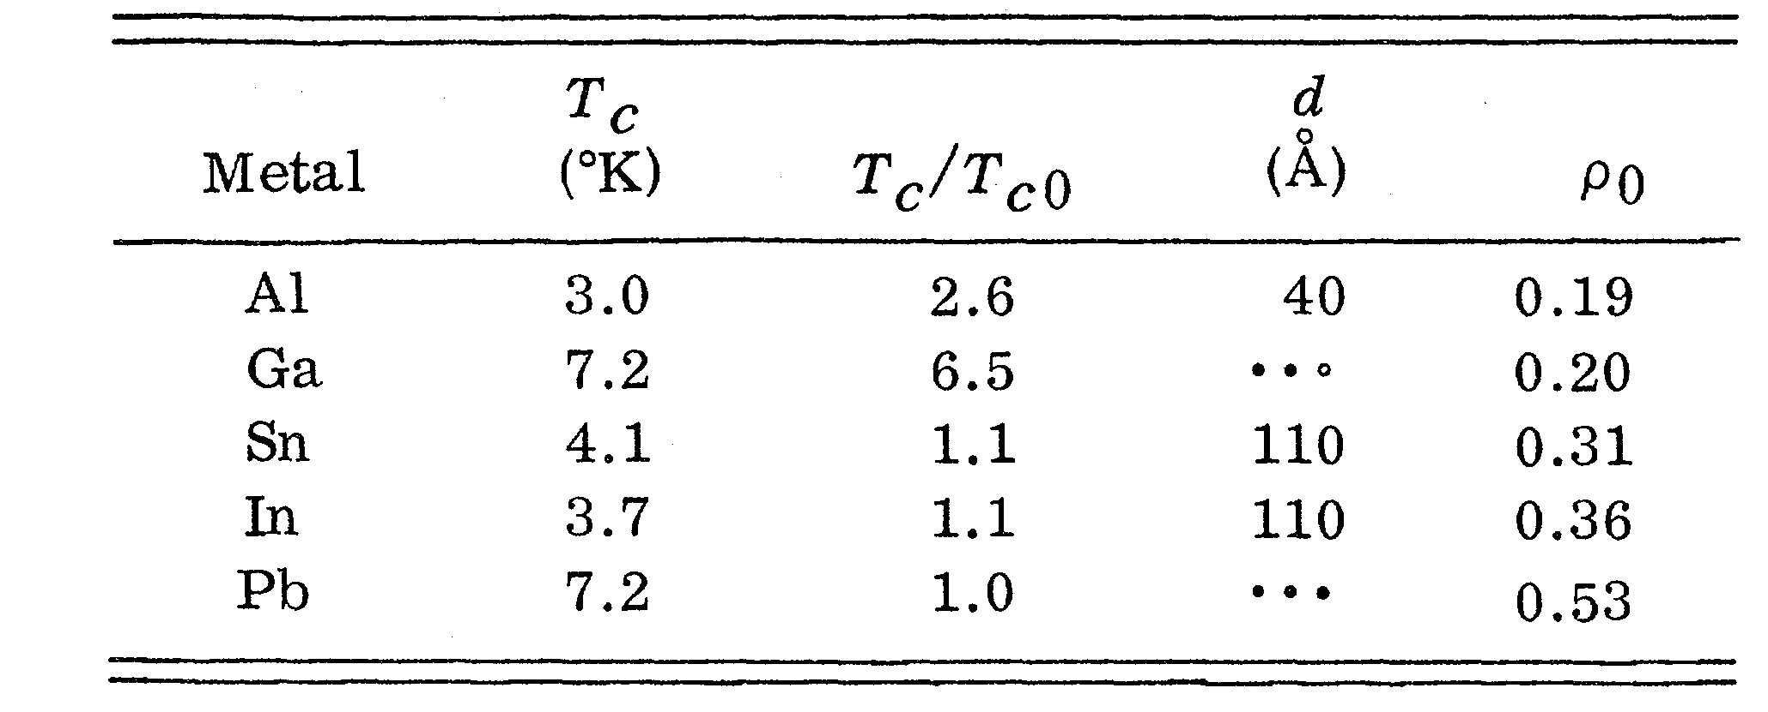
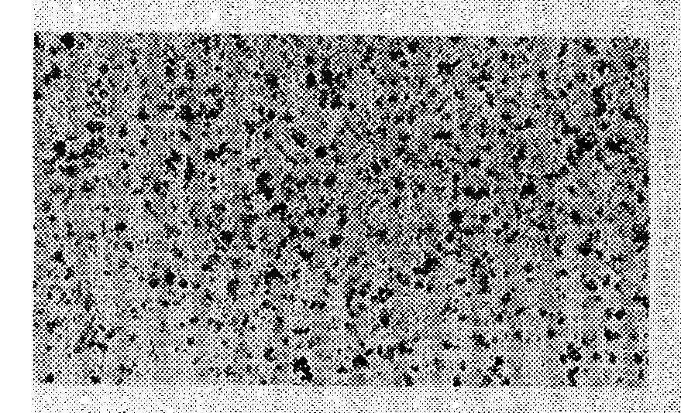
Thin Films?
Abeles, Cohen, Cullen, Phys. Rev. Lett., 17, 632 (1966)
Crow, Parks, Douglass, Jensen, Giaver, Zeller....
A.M. Goldman, Dynes, Tinkham…

Slide 6
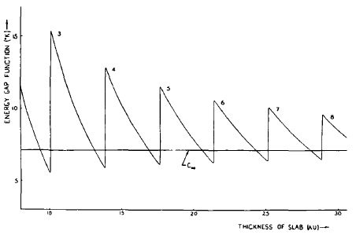
Thin Films
>10T_{c}!
Shape Resonances
Fluctuations?
Charge neutrality?
Substrate?
Blatt, Thompson, Phys. Lett. 5, 6 (1963)
Yu, et al.,Rev. B 14, 996 (1976)
Bermudez, AGG, Phys. Rev. B 89, 064508 (2014) 89, 024510 (2014)

Slide 7
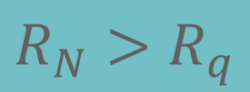
Thinner
Smoother
Disordered
BKT
Transition
$$R_{N}>R_{q}$$
(anti)Vortex unbinding
A.M. Goldman et al.
PRL 62 2180 (1989)
PRB 47 5931 (1993)

Slide 8
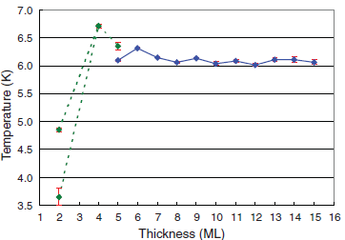
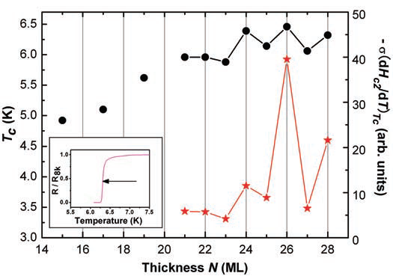
2000
Atomic scale control
Pb
Shih et al., Science 324, 1314 (2009)
Xue et al., Science 306, 1915 (2004)
Size effects but not higher Tc

Slide 9
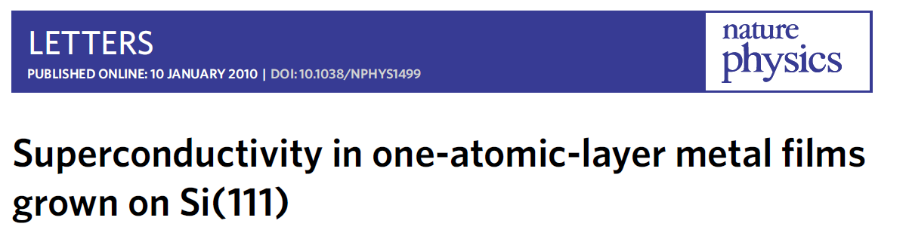
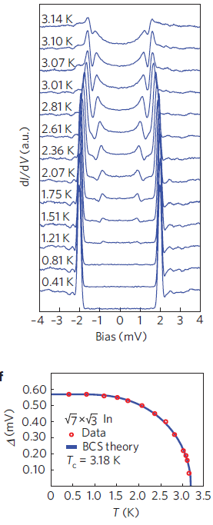
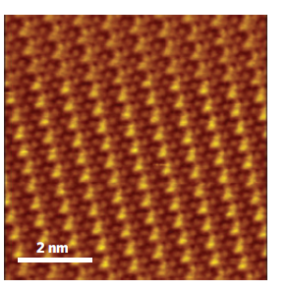
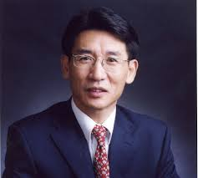
Epitaxial growth
STM
Impurities?
Xue
Tsinghua

Slide 10
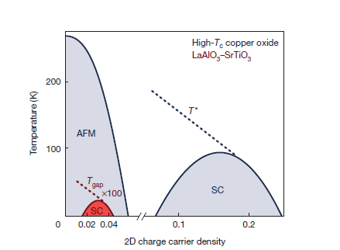
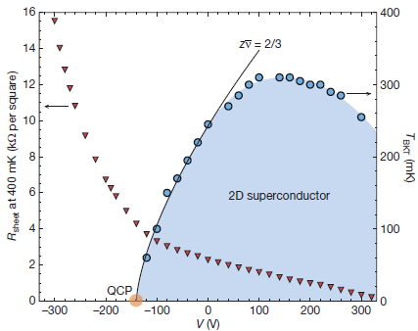
LaAlO₃ /SrTiO₃ interface
Triscone et al. , Nature 456 624 (2008)
Mannhart et al., Nature 502, 528 (2013)
Localization
Control
Exotic Quantum Matter
Tunability
Topology

Slide 11
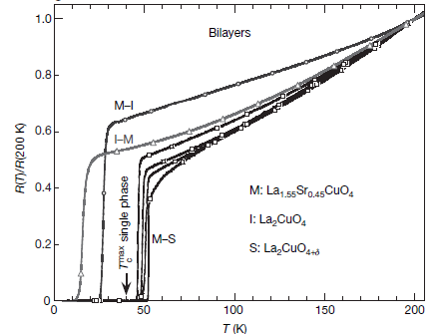
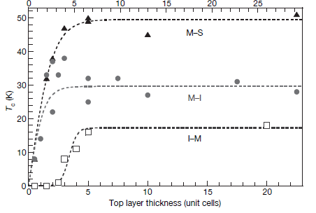
Cuprates high T_{c} Heterostructures
Bozovic et al., Nature 455, 782 (2008)
Higher T_{c}!!

Slide 12
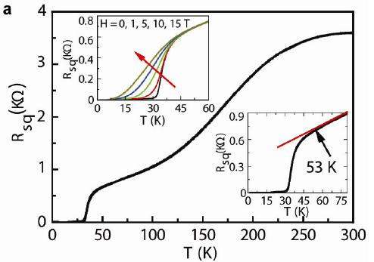
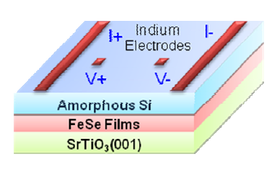
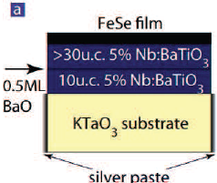
Iron Based Heterostructures
Nature Comm. 3, 931 (2013), Chinese Phys. Lett. 29 037402 (2012)
Feng, et. al, Nat. Commun. 5:5044 (2014)

Slide 13
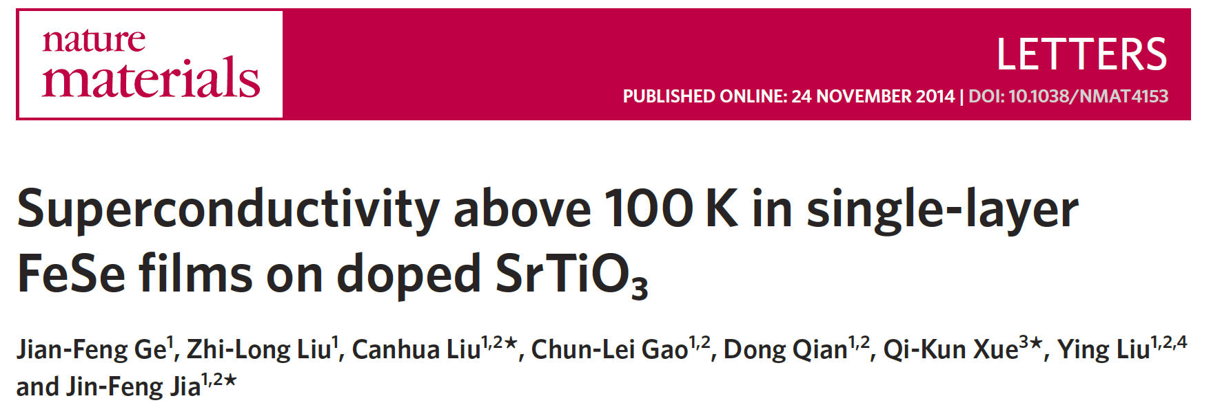
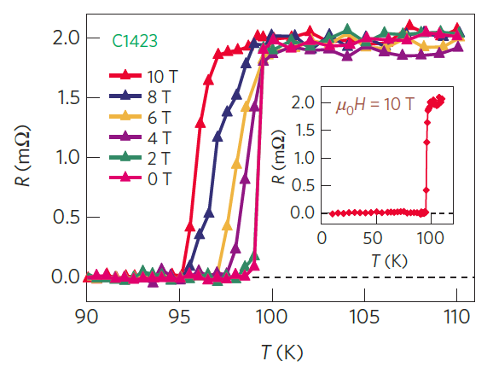
Bulk FeSe
8K!

Slide 14
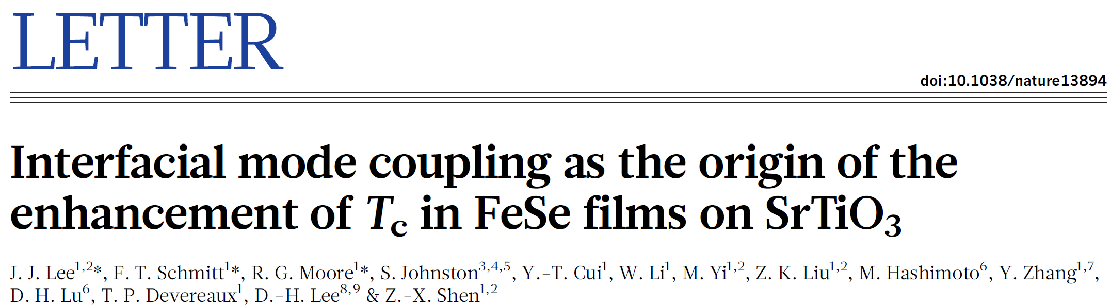
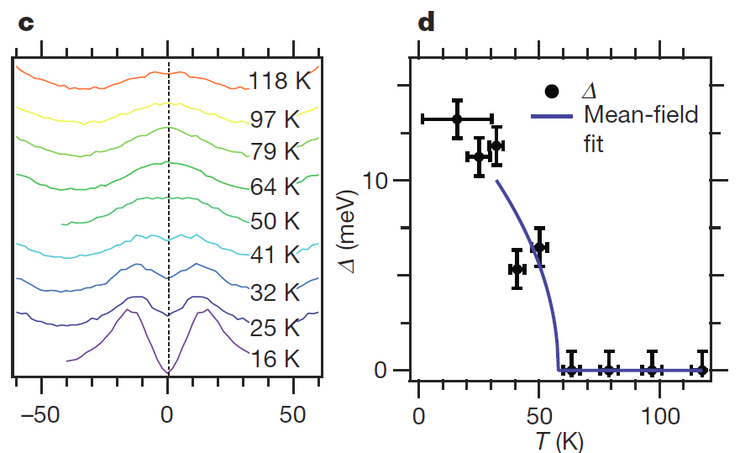
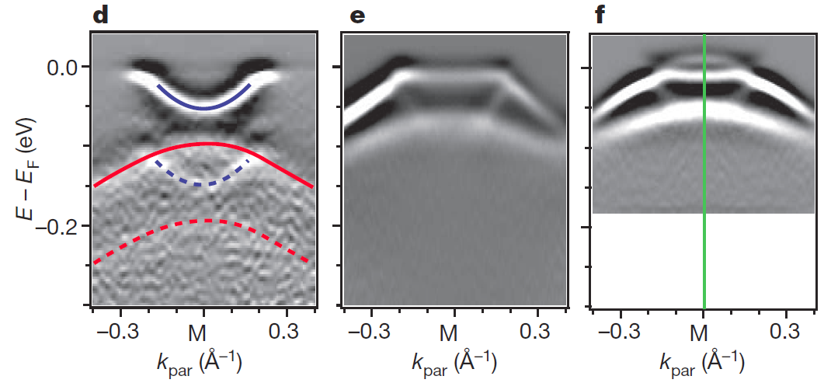
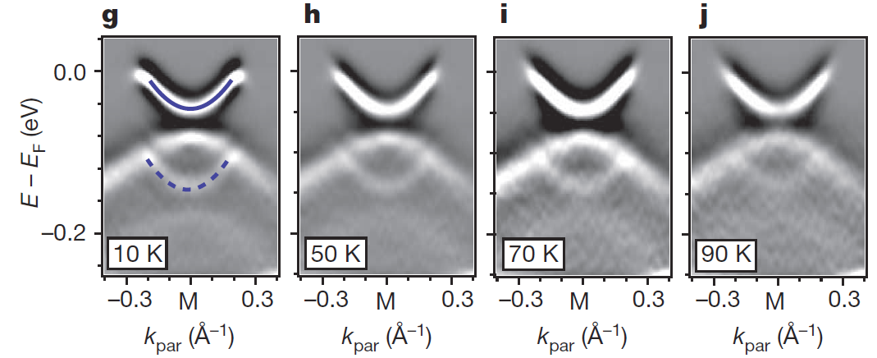
STO is key!

Slide 15
Nano-grains

Slide 16
Single grains?
Abeles, Cohen, Cullen, Phys. Rev. Lett., 17, 632 (1966)
Crow, Parks, Douglass, Jensen, Giaver, Zeller....
A.M. Goldman, Dynes, Tinkham…

Slide 17
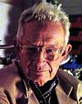
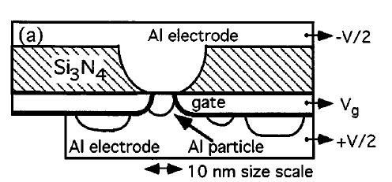
Δ ~ δ
Ralph, Black,Tinkham, Superconductivity in Single Metal Particles PRL 74, 3241-3244 (1995).
Superconductivity?
1959
Yes, superconductivity
Isolated grain?
Odd-even effects
Rediscovery of
Richardson’s equations
No yet quantitative

Slide 18
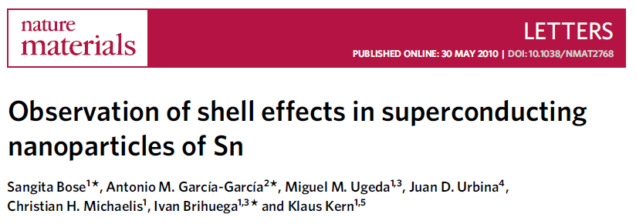
7 nm
0 nm

Slide 19
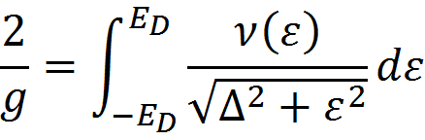
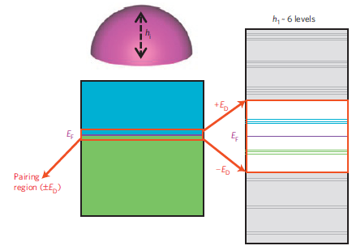
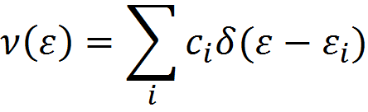
BCS superconductivity
Finite size effects
V → ∞ Δ~ ε_{D}e^{-1/λ}
V finite Δ=?
Level Degeneracy
Shell Effects
Parmenter, Phys. Rev. 166, 392 (1967)
L ~ 5nm
20T_{c}!

Slide 20
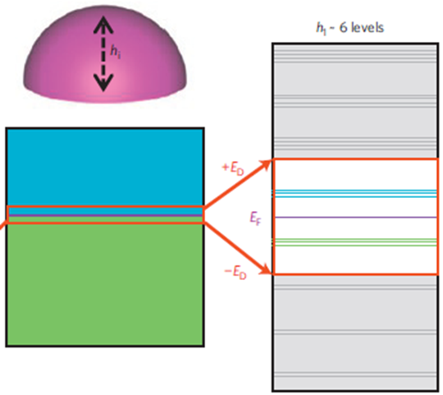
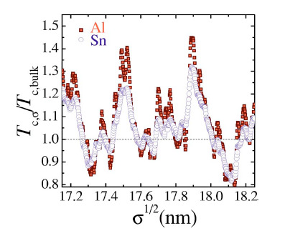
Δ >> δ
Grains
Heiselberg (2002): harmonic potentials, cold atom
Kresin, Ovchinnikov, Boyaci (2007) : Spherical, too high T_{c}
Peeters, et al, (2005-): BCS, BdG in a wire, cylinder..
Devreese (2006): Richardson equations in a box
Olofsson (2008): Estimation of fluctuations in BCS

Slide 21
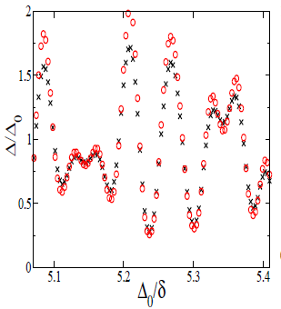

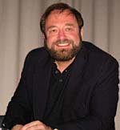
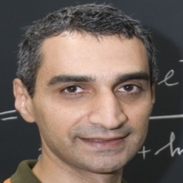
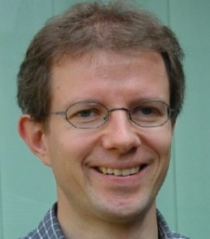


Δ >> δ
L ~ 10nm
Expansion in 1/k_{F}L, δ/∆₀
AGG, Altshuler, PRL 100, 187001 (2008) AGG, Altshuler, PRB 83, 014510 (2011)

Slide 22
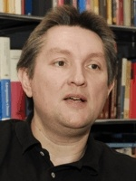

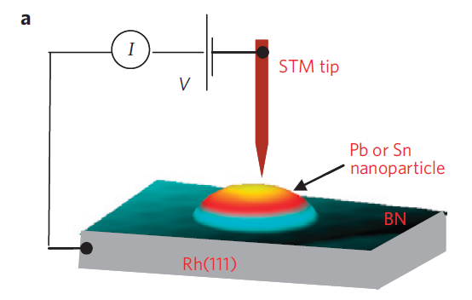
Single, Isolated Sn and Pb grains
7 nm
Kern
Bose
R ~ 4-30nm
A gap is still observed
0 nm
Almost hemispherical
STM
Tunneling conductance

Slide 23
+
Bose, AGG, Nature Materials 2010

Slide 24


Beyond mean field
Δ ~ δ
Quantum Fluctuations
Richardson’s equations
and
Thermal Fluctuations
Static Path Approach
Brihuega, AGG, Ribeiro, Bose, Kern PRB 84,104525 (2011)
Editor‘s Suggestion

Slide 25



Quantum + Thermal?
T, δ/ Δ₀ << 1
Divergences at intermediate T
Rossignoli and Canosa
Ann. of Phys. 275, 1, (1999)
Harmful Zero Modes
Polar coordinates
Quantum fluctuations ~ Charging effects
Ribeiro and AGG, Phys. Rev. Lett. 108, 097004 (2012)

Slide 26



True phase coherence in single nanograins?
No
$$ΔNΔφ≥ℏ$$
Josephson
array?
Maybe
Mason, et al, Nature Physics 8 59 (2012)

Slide 27


Engineering inhomogeneous materials
James Mayoh
Inhomogeneous JJ arrays
Experimentally feasible
$$L∼5nm σ∼1nm$$
3D nano-spheres
Charging effects
Global T_{c} > Bulk T_{c}?
Topology, Matthews, Ribeiro, and AGG, PRL 112, 247001(2014)
Nano-granularity Mayoh, AGG. PRB 90, 134513 (2014)
Disorder, Mayoh, AGG, 1412.0029 PRX (?)

Slide 28








1 Nano-Grain
$$Δ\left(ε,r,L\right)$$
+
Tunnelling
I
N
H
O
M
O
G
E
N
E
O
U
S
3D Array
Schoen, Zaikin, Fazio
Charging
Hopping
Quasiparticles
H
O
M
O
G
E
N
E
O
U
S
T
#SCG
Percolation ?

Slide 29

Percolation?
Phase fluctuations?
T
#SCgrains
T_{c}?
R=5nm σ=1nm λ=0.3

Slide 30







Packing = FCC, BCC, Cubic
$$σ=1 nm$$
$$\overline{R}=5 nm$$
$$λ=0.25$$
Enhancement!
Patent
Mark Blamire
Cambridge

Slide 31

SURPRISE!

Slide 32


Engineering FeSe/STO
Interface design
Nano-granularity
Xue
Tsinghua
Lara Benfatto
Rome
Xue et.al PRB B91 060509(R) (2015)

Slide 33

Inhomogeneities by disorder
Energy gap
Order parameter
$$Δ(r)$$
Global T_{c}
Can disorder enhance superconductivity?

Slide 34




Some bad news
BdG too difficult
BCS doable
$$u_{n},v_{n}∝ψ_{n}$$
but valid only if

Slide 35
Disorder and superconductivity
Anderson Theorem
Gorkov, Anderson 50’s
(Do not worry about disorder)
Localization and SC can coexist
Ma & Lee 80’s
Weak localization weakens SC
Maekawa, Finkelstein 80’s
Numerical BdG
Emergent granularity
Trivedi et al., Meir 90’s
Pseudogap, Goldstone, Higgs modes, gap distribution function
Sacepe, Benfatto, Raychaudhuri
Multifractal disorder
Kravtsov, Mirlin

Slide 36


Enhancement of Tc by disorder
Fractal distributions of dopants enhance Tc in cuprates
Bianconi, et al., Nature 466, 841 (2010)
Inhomogeneities
Higher T_{c}
PRL 108, 017002 (2012)
PRL, 98, 027001 (2007)

Slide 37








Strong multifractality and superconductivity
Feigelman, Ioffe, Kravtsov, Yuzbashyan, Phys. Rev. Lett. 98, 027001 (2007)
I. S. Burmistrov, I. V. Gornyi, A. D. Mirlin, Phys. Rev. Lett. 108, 017002 (2012)
3d MIT
~ 0.4
$$T_{c}≥1000K$$

Slide 38







Weak multifractality and superconductivity
J. Mayoh and AGG, PRB 92 174526 (2015)
Where?
What?
(Ultra) Thin films
$Δ(ε_{F})$ energy gap
2D + Spin orbit
$Δ\left(ε\right)$ energy dependence
1D + Long Range
$Δ(r)$ spatial distribution
How?
Global T_{c}!
$$λ,γ≪1$$
Can disorder enhance SC?
$$BCS,ε_{D }fixed$$
Percolation

Slide 39







$$Δ\left(ε_{F}\right)=Δ_{γ}$$
$$Fixed λ$$
$$Fixed ε_{D}/E_{0}$$
Still unrealistic
Why?
Not true Tc
Inhomogenous SC

Slide 40





$$γ∼1/g$$
Global Tc?
Log-Normal distribution
Sacepe et al., Nat. Phys. 7 239 (2011)
Lemarie, Benfatto, et al., PRB 87, 184509 (2013)
Tracy-Widom?

Slide 41






Global T_{c}?
$$λ=0.25$$
$$φ\sim φ_{c}$$
$$φ_{c}=0.675,0.7,0.75,0.8$$
Enhancement?
$$λ≤0.3$$
Yes
But
Al is fine! FeSe/STO?

Slide 42
Out of equilibrium superconductivity

Slide 43






The out of equilibrium birth of a superfluid
Phys. Rev. X 5, 021015 (2015)
$$ξ_{eq}=ξ_{0}{\left|ε\right|}^{−ν}$$
Hong Liu
MIT
Paul Chesler
Harvard
$$τ_{eq}=τ_{0}{\left|ε\right|}^{−νz}$$
Unbroken Phase
Broken phase
$$〈ψ〉=0$$
T_{c}
$$〈ψ〉≠0$$
T(t)
$〈ψ〉=Δ\left(x,t\right)e^{iθ\left(x,t\right)} ?$

Slide 44


Kibble J. Phys. A: Math. Gen. 9: 1387. (1976)
Causality
Vortices in the sky
Generation of Structure
Cosmic strings
Krusius, 2006
Weyler, Nature 2008

Slide 45








$$1−\frac{T\left(t\right)}{T_{c}}=ε\left(t\right)=t/τ_{Q}$$
$$τ_{eq}\left(t\right)∝{\left|ε\right|}^{−νz}$$
$$τ_{eq}\left(\hat{t}\right)∼\hat{t}$$
Zurek Nature 317 (1985) 505
Adiabatic
Frozen
Adiabatic
$$−\hat{t}$$
Tc
$$\hat{t}$$
t
$$\hat{ξ}=ξ_{0}{\left|\hat{ε}\right|}^{−ν}=ξ_{0}{\left({τ_{Q}}/{τ_{0}}\right)}^{ν/(1+νz)}$$
Kibble-Zurek mechanism
$$ρ∼{\hat{ξ}}^{−d}∼{τ_{Q}^{}}^{−dv/(1+vz)}$$

Slide 46


KZ scaling with the quench speed
Too few defects

Slide 47

Issues with KZ
Too many defects
Adiabatic at t_{freeze}?
Defects without a condensate?
$t_{eq}>t>t_{freeze}$ is relevant
Phys. Rev. X 5, 021015 (2015)
Chesler, AGG, Liu

Slide 48




Slow Quenches
Linear response
$$t>t_{freeze}$$
Scaling
KZ
Frozen
Adiabatic
US
Frozen
Coarsening
Adiabatic
$$t_{freeze}$$
$$t_{eq}$$
$$\frac{t_{eq}}{t_{freeze}} ∼ {\left(\log{R}\right)}^{\frac{1}{1+νz}}$$
$$ρ\left(t_{eq}\right)∼{\left[\log{R}\right]}^{γ}ρ_{KZ}$$
$$R∼ξ^{−1}{τ_{Q}^{}}^{Λ/{1+νz}}$$
$$γ=\frac{1+\left(z−2\right)ν}{2(1+zν)}$$
$${\left|ψ\right|}^{2}\left(t\right)∝e^{a_{2}{\overline{t}}^{1+zν}}$$
$$Λ=\left(d−z\right)ν−2β$$

Slide 49


Numerics
U(1) theory with a gravity dual
t_{eq} is the relevant scale

Slide 50




Slow quenches
Adiabatic
Non adiabatic

Slide 51




Slow
Fast
$$ρ∼\frac{ρ_{KZ}}{{\left(log{{(N}^{2}}/{{τ_{Q}^{}}^{1/2})}\right)}^{1/2}}$$
Slow
Fast
$$ρ∼\frac{ε_{f}}{log⁡(\frac{N^{2}}{ε_{f}})}$$
$$ε_{f}=1−T_{f}/T_{c}$$
~25 times less defects than KZ prediction!!
Relevant for ⁴He, materials ?

Slide 52
Materials nano-design
Interfaces
Heterostructures
Thermalization, steady non-thermal, dynamical transitions
Out of equilibrium
Quantum Information
Bounds on transport “Universal quantum constraints on the butterfly effect” D. Berenstein, AGG, 1510.08870
Emergent quantum matter
Many-body Efimov in condensed matter, topology

Slide 53
THANKS!
感谢您的关注

Slide 54
Can disorder enhance superconductivity?
Trivedi, Meir…..
Pratap, Sacepe…..
Numerics
Experiments
Strong coupling and disorder
Strong disorder and no weak coupling
AGG,Tezuka, 2011
Abeles,… 60’s
Gor'kov and Abrikosov
Finkelstein A M, 1987
Anderson theorem
Weak localization
Anderson, J. Phys. Chem. Solids 11, 26 (1959)
Maekawa S, Fukuyama H, 1982
Anderson theorem is all but a theorem
Be careful with BCS+Perturbation

Slide 55







Many body Efimov Physics
Bound states
Efimov 70’s
Scaling

Slide 56

RGM
Born-Oppenheimer

Slide 57
AdS/CFT Maldacena1997
Strongly coupled field theory in d
Weakly coupled gravity in d+1
N=4 Super-Yang Mills
CFT
Anti de Sitter space
AdS
2003
QCD Quark gluon plasma
2008
Holographic superconductivity
2012
Quantum criticality, non-equilibrium..
Easy to compute in the gravity dual
&
Detailed dictionary

Slide 58


Slide 60


Slide 61




Slide 62

Anderson Metal-Insulator Transitions
Multifractal eigenstates
Wegner, Aoki, Castellani, Efetov

Slide 63
Experimental tests
STM in thin films log² distribution
Disorder
Transport to test higher global Tc
Nano engineering
L ~ 5-10nm?
Conclusion
FeSe?
Enhancement?
Only in boring materials?
Sure
MgB₂?

