Slide 1
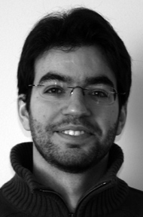

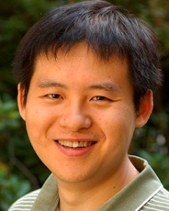

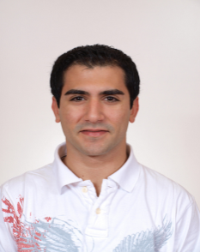
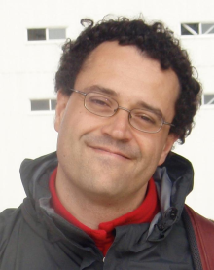
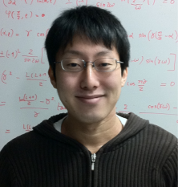
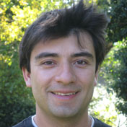
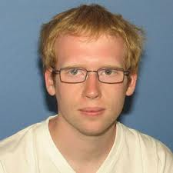


Smaller is different and more: Low dimensional superconductivity for new physics and applications
Antonio M. García-García
Cavendish Laboratory, Cambridge University
Tezuka
Kyoto
Hong Liu
MIT
Paul Chesler Harvard
Bermudez
Cambridge
Pedro Ribeiro Lisbon
Naidon RIKEN
Cazalilla Tsinghua
Endo Paris, ENS
Lobos Maryland
Mayoh
Cambridge

Slide 2


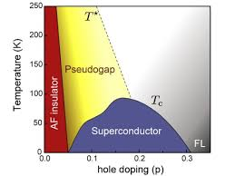
Superconductivity For Happiness
Trial and error
Mavericks
Quantum critical points ©
Cuprates ~100K 1986 Mueller & Bednorz
MgB₂ 39K 2001 Akimitsu
FeSC ~50K 2006 Hotsono

Slide 3
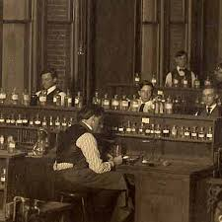
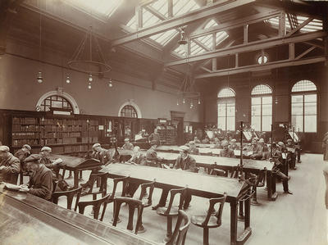
Pb ~7K Al ~1K Sn ~3.7K Nb ~9.3K
Librarians
Thinner
Cleaner
Smaller
DFT
BCS + (weak) disorder, interactions..
Thin films
Josephson Junctions
Control
Nanowires

Slide 4
Mavericks meet Librarians
A revolution is going on
Experimental Control
Theory does not drift
True Design of Materials!
Enhancement of superconductivity?
Conventional SC in low dimensions
Artificial hetero,nano-structures
Novel Interfaces FeSe/STO, LAO/STO

Slide 5
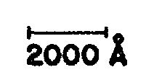
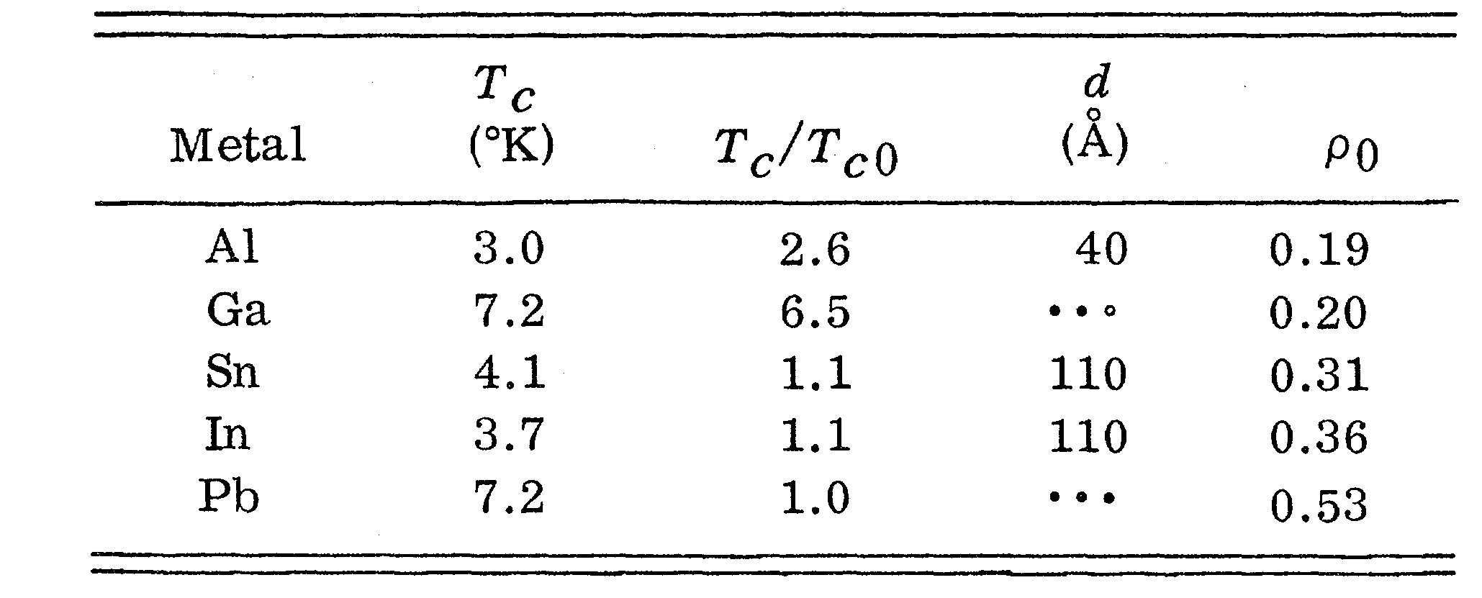
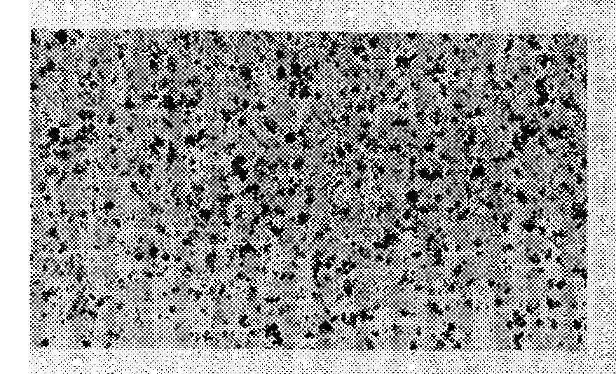
Thin Films?
Abeles, Cohen, Cullen, Phys. Rev. Lett., 17, 632 (1966)
Crow, Parks, Douglass, Jensen, Giaver, Zeller....
A.M. Goldman, Dynes, Tinkham…

Slide 6
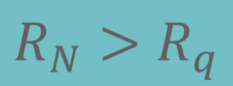
Thinner
Smoother
Disordered
BKT
Transition
$$R_{N}>R_{q}$$
(anti)Vortex unbinding
A.M. Goldman et al.
PRL 62 2180 (1989)
PRB 47 5931 (1993)

Slide 7
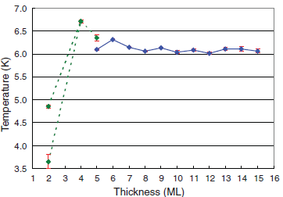
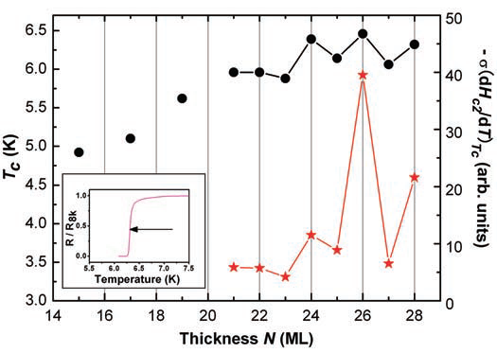
2000
Atomic scale control
Pb
Shih et al., Science 324, 1314 (2009)
Xue et al., Science 306, 1915 (2004)
Size effects but not higher Tc

Slide 8
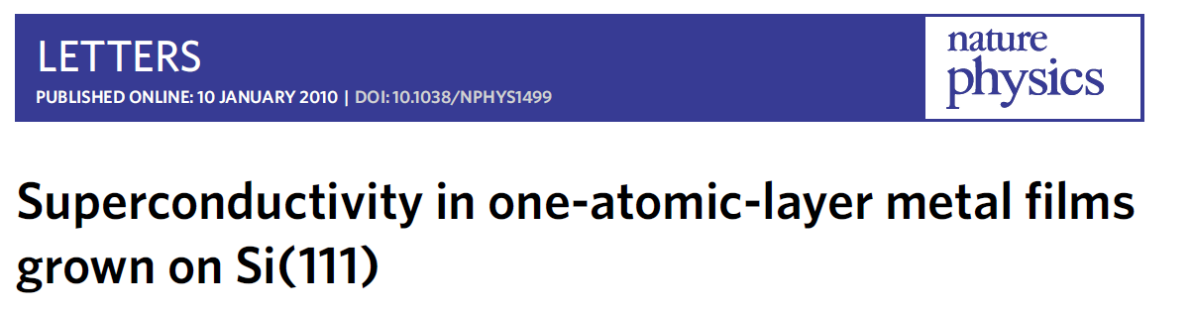
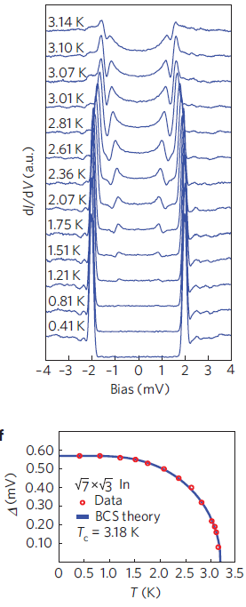
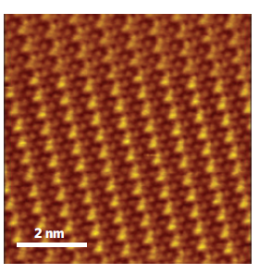
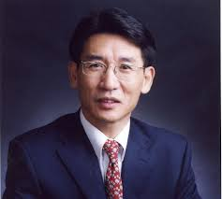
Epitaxial growth
STM
Impurities?
Xue
Tsinghua

Slide 9
One-layer + transport?
source, drain,and gate electrodes….
STM? Only spectrum?
Four point STM probe = Transport + one-layer!!
Shiraki, I., Tanabe, F., Hobara, R., Nagao, T., Hasegawa, S., Surf. Sci. 493, 633 (2001)
Ishikawa et al. Jpn. J. Appl. Phys. 44, 1502 (2005)

Slide 10
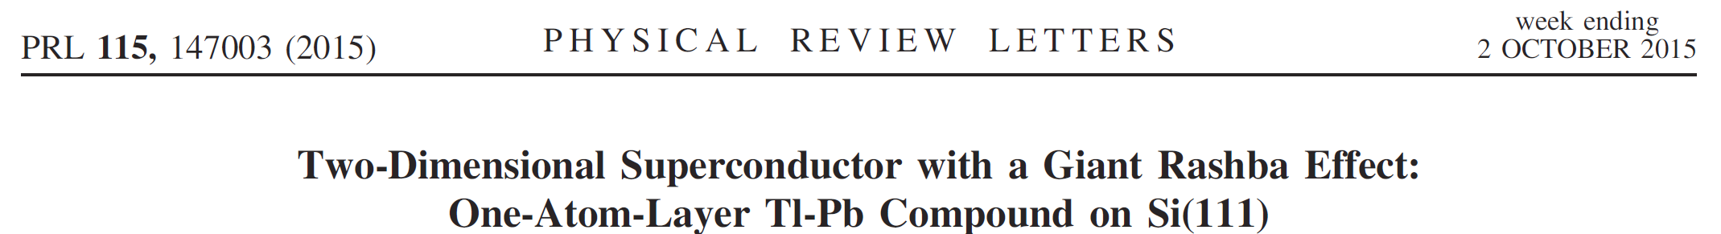
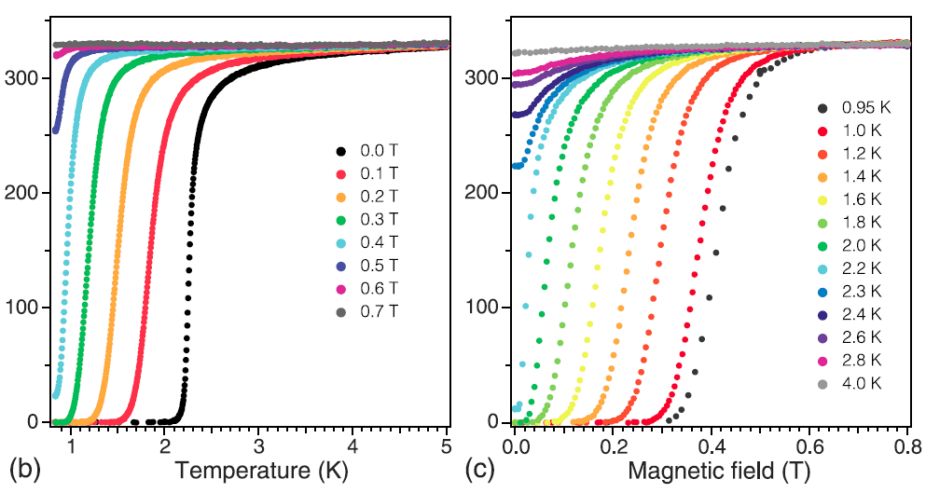
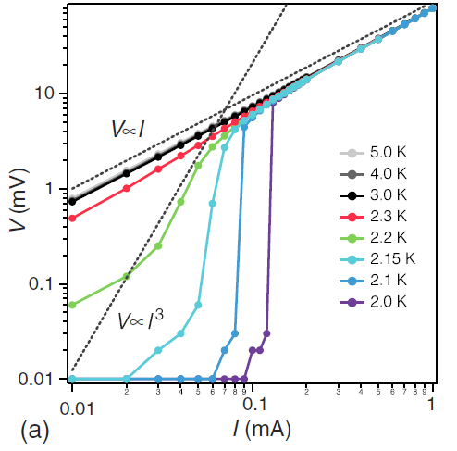
More exp control
Less drift in theory
BKT physics
Intrinsic topological SC?

Slide 11
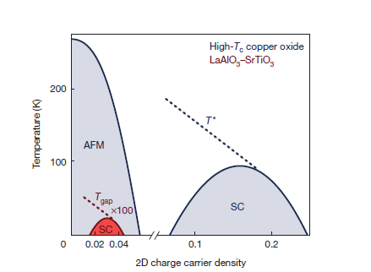
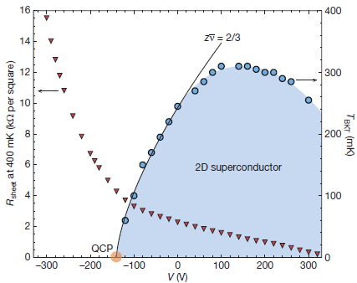
LaAlO₃ /SrTiO₃ interface
Triscone et al. , Nature 456 624 (2008)
Mannhart et al., Nature 502, 528 (2013)
Localization
Control
Exotic Quantum Matter
Tunability
Topology

Slide 12
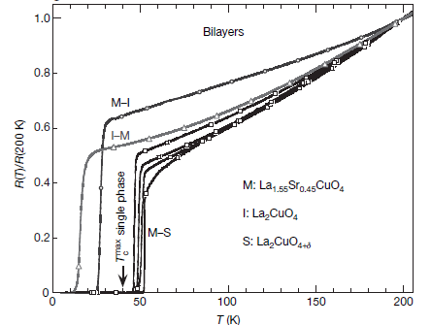
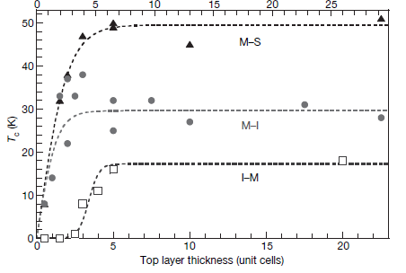
Cuprates high T_{c} Heterostructures
Bozovic et al., Nature 455, 782 (2008)
Higher T_{c}!!

Slide 13
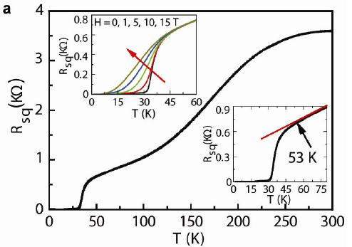
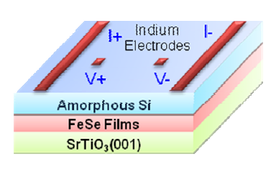
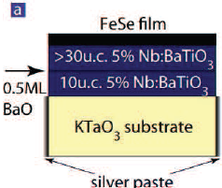
Iron Based Heterostructures
Nature Comm. 3, 931 (2013), Chinese Phys. Lett. 29 037402 (2012)
Feng, et. al, Nat. Commun. 5:5044 (2014)

Slide 14
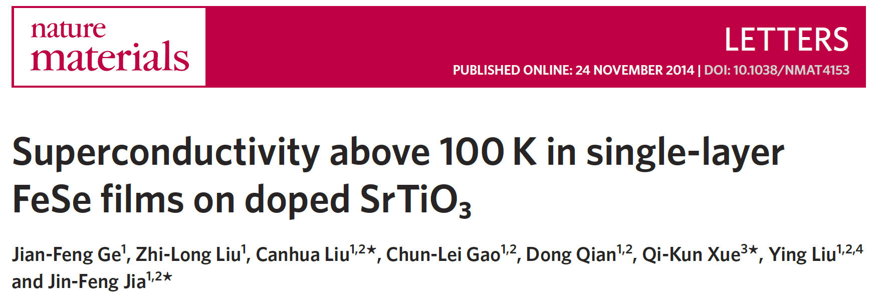
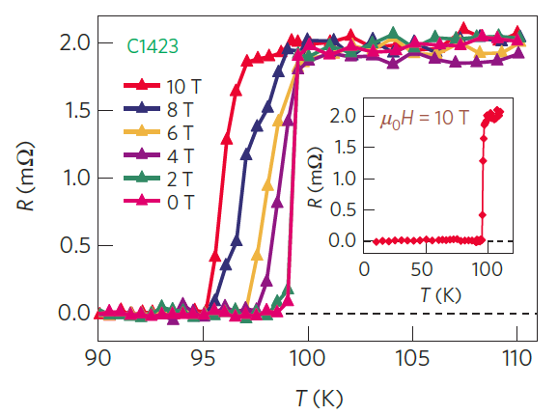
Bulk FeSe
8K!

Slide 15
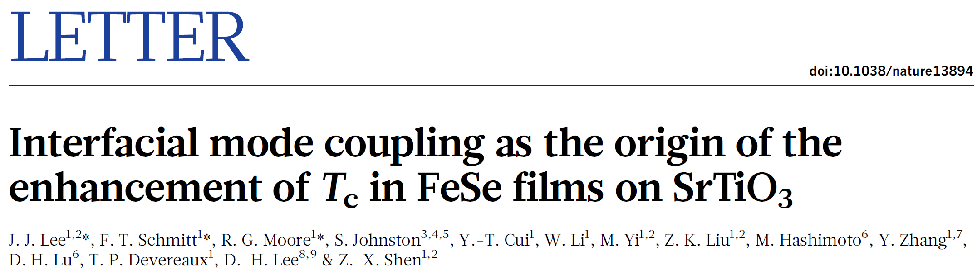
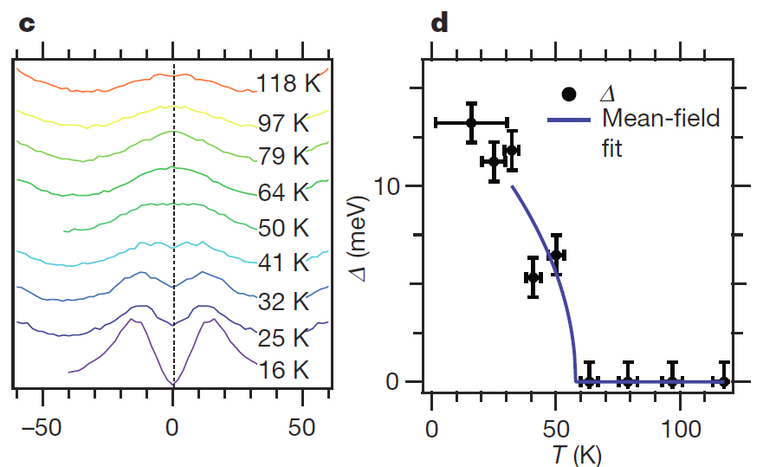
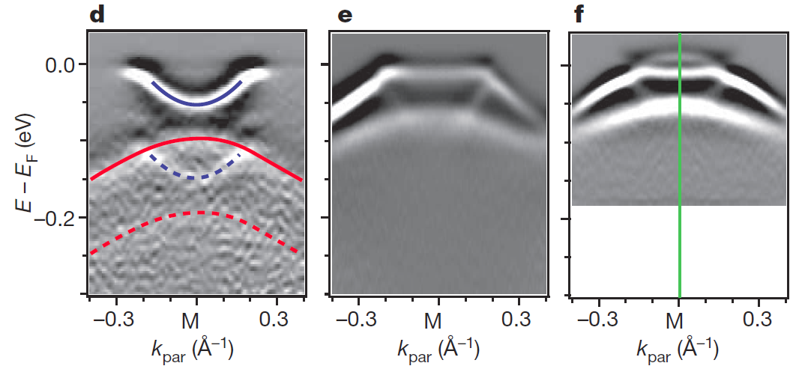
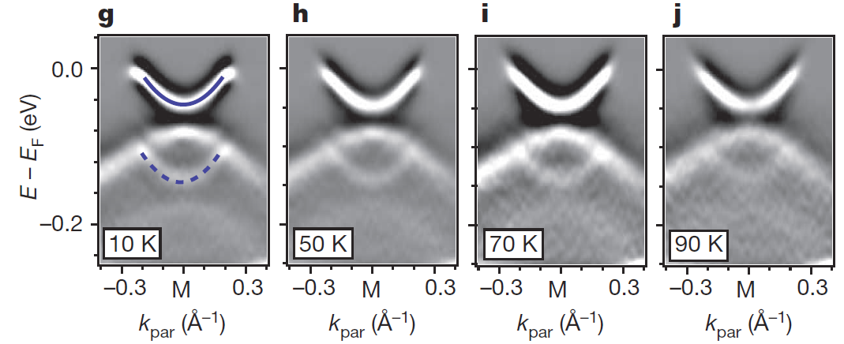
STO is key!

Slide 16
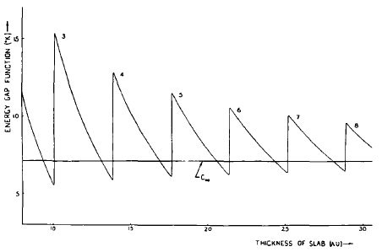
Thin Films
>10T_{c}!
Shape Resonances
Fluctuations?
Charge neutrality?
Substrate?
Blatt, Thompson, Phys. Lett. 5, 6 (1963)
Yu, et al.,Rev. B 14, 996 (1976)
Bermudez, AGG, PRB 89, 064508 (2014), PRB 89, 024510 (2014)

Slide 17

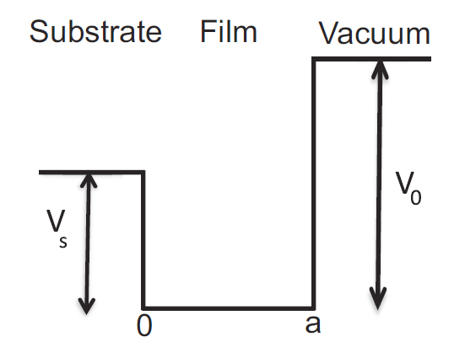
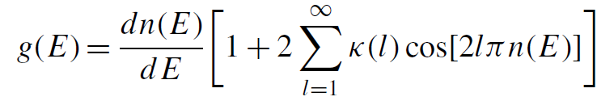

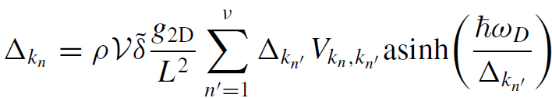

Ultra Thin films + substrate + finite life time?
Charge neutrality
Aurelio Bermudez
Effective extra width
Level broadening
Mean field

Slide 18
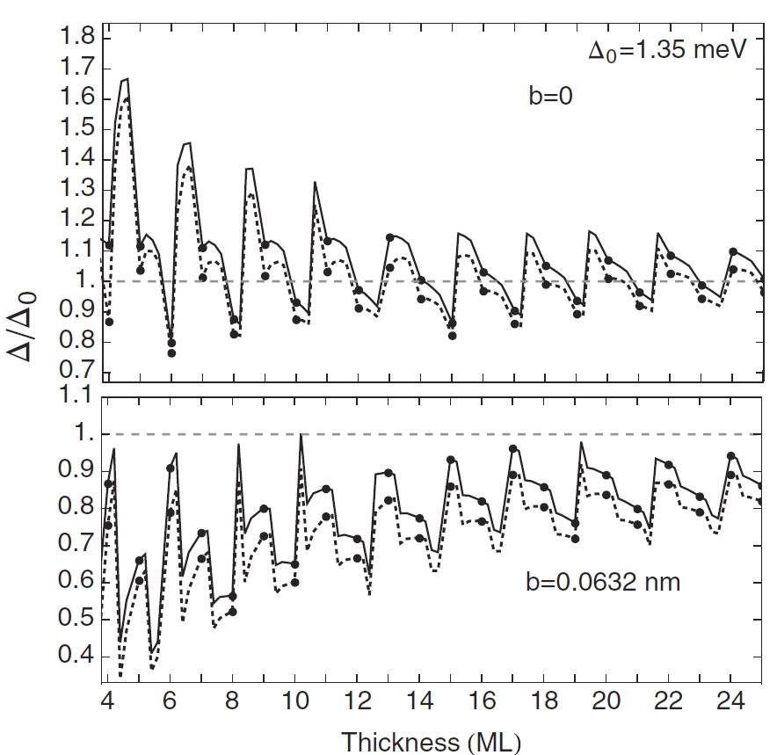
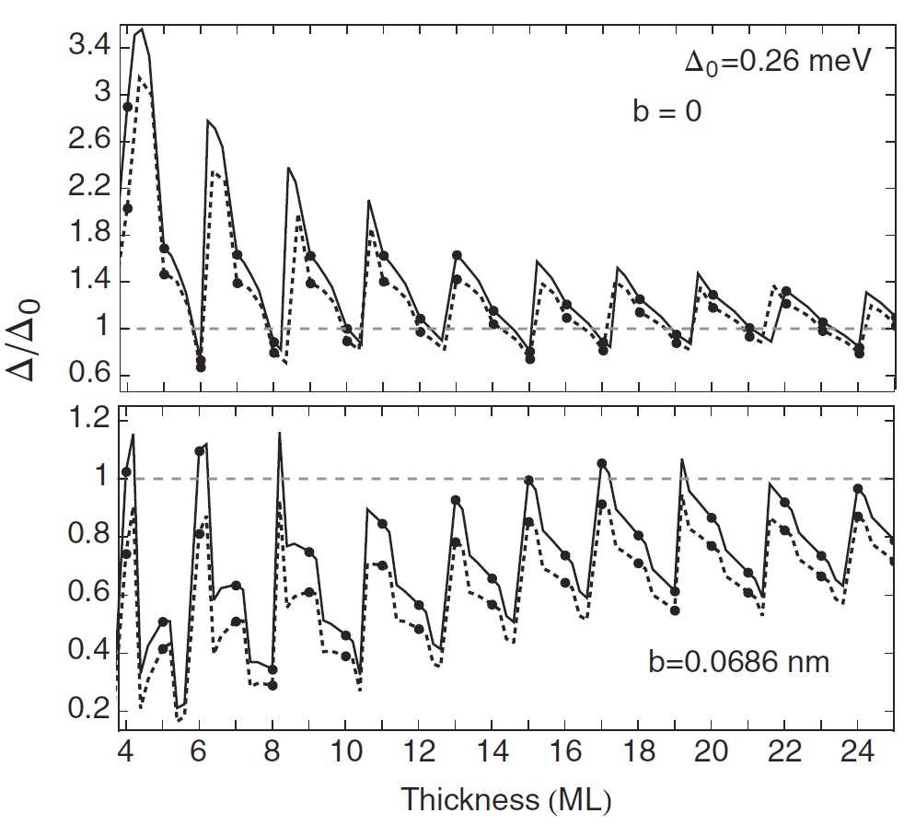
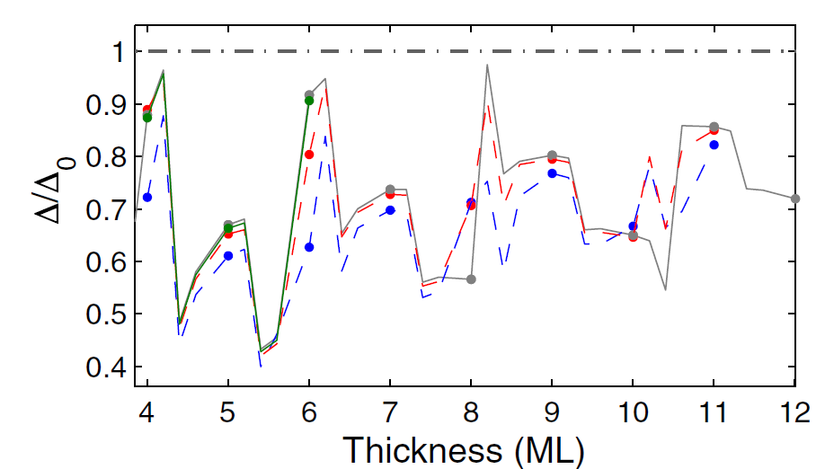
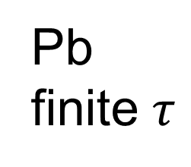
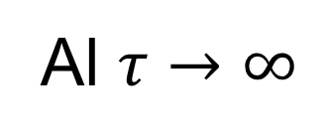
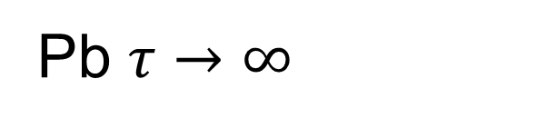
Pb $τ→∞$
Al $τ→∞$
Pb finite $τ$

Slide 19
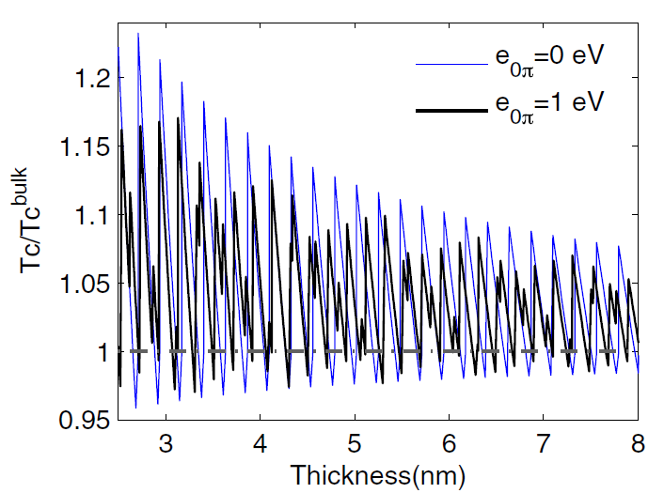
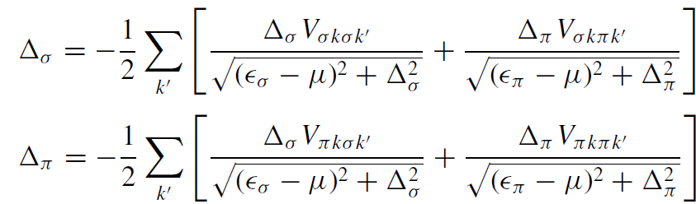
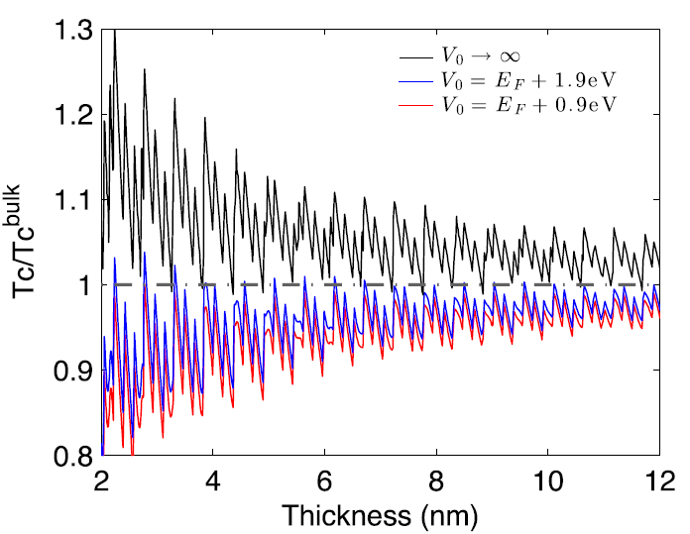
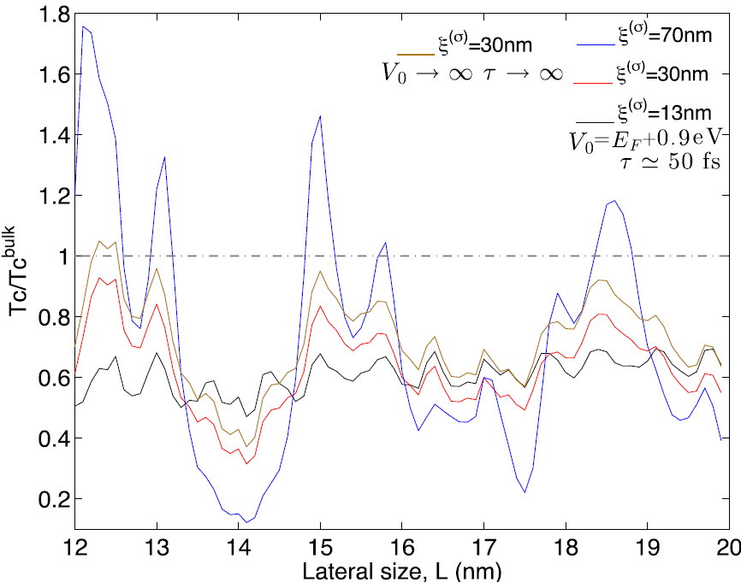
Multiband superconductors MgB₂
1 band & 2 band
2 band + substrate
2 band + finite lateral
Multiband suppresses size effects
Size effects still sizable
Can charge neutrality be relaxed in novel interfaces?

Slide 20
Nano-grains

Slide 21
Single grains?
Abeles, Cohen, Cullen, Phys. Rev. Lett., 17, 632 (1966)
Crow, Parks, Douglass, Jensen, Giaver, Zeller....
A.M. Goldman, Dynes, Tinkham…

Slide 22


Δ ~ δ
Tinkham et al., Superconductivity in Single Metal Particles PRL 74, 3241 (1995).
Superconductivity?
1959
Yes, superconductivity
Isolated grain?
Odd-even effects
Rediscovery of
Richardson’s equations
No yet quantitative

Slide 23



BCS superconductivity
Finite size effects
V → ∞ Δ~ ε_{D}e^{-1/λ}
V finite Δ=?
Level Degeneracy
Shell Effects
Parmenter, Phys. Rev. 166, 392 (1967)
L ~ 5nm
20T_{c}!

Slide 24


Δ >> δ
Grains
Heiselberg (2002): harmonic potentials, cold atom
Kresin, Ovchinnikov, Boyaci (2007) : Spherical, too high T_{c}
Peeters, et al, (2005-): BCS, BdG in a wire, cylinder..
Devreese (2006): Richardson equations in a box
Olofsson (2008): Estimation of fluctuations in BCS

Slide 25







Δ >> δ
L ~ 10nm
Expansion in 1/k_{F}L, δ/∆₀
AGG, Altshuler, PRL 100, 187001 (2008) AGG, Altshuler, PRB 83, 014510 (2011)

Slide 26



Single, Isolated Sn and Pb grains
7 nm
Kern
Bose
R ~ 4-30nm
A gap is still observed
0 nm
Almost hemispherical
STM
Tunneling conductance

Slide 27


Slide 28


Beyond mean field
Δ ~ δ
Quantum Fluctuations
Richardson’s equations
and
Thermal Fluctuations
Static Path Approach
Brihuega, AGG, Ribeiro, Bose, Kern PRB 84,104525 (2011)
Editor‘s Suggestion

Slide 29



Quantum + Thermal?
T, δ/ Δ₀ << 1
Divergences at intermediate T
Rossignoli and Canosa
Ann. of Phys. 275, 1, (1999)
Harmful Zero Modes
Polar coordinates
Quantum fluctuations ~ Charging effects
Pedro Ribeiro
Ribeiro and AGG, Phys. Rev. Lett. 108, 097004 (2012)

Slide 30

1D JJ array T=0
Capacitance+fluctuations+quasiparticles
Homogeneous Amplitude
C=0, Superconductivity at T=0 for L > L_{c}
Fluctuations sometimes good for SC
P. Ribeiro, AGG, PRB 89, 064513 (2014)

Slide 31



True phase coherence in single nanograins?
No
$$ΔNΔφ≥ℏ$$
Josephson
array?
Maybe
Mason, et al, Nature Physics 8 59 (2012)

Slide 32


Engineering inhomogeneous materials
James Mayoh
Inhomogeneous JJ arrays
Experimentally feasible
$$L∼5nm σ∼1nm$$
3D nano-spheres
Charging effects
Global T_{c} > Bulk T_{c}?
Topology, Matthews, Ribeiro, and AGG, PRL 112, 247001(2014)
Nano-granularity Mayoh, AGG. PRB 90, 134513 (2014)
Disorder, Mayoh, AGG, 1412.0029 PRX (?)

Slide 33








1 Nano-Grain
$$Δ\left(ε,r,L\right)$$
+
Tunnelling
I
N
H
O
M
O
G
E
N
E
O
U
S
3D Array
Schoen, Zaikin, Fazio
Charging
Hopping
Quasiparticles
H
O
M
O
G
E
N
E
O
U
S
T
#SCG
Percolation ?

Slide 34

Percolation?
Phase fluctuations?
T
#SCgrains
T_{c}?
R=5nm σ=1nm λ=0.3

Slide 35







Packing = FCC, BCC, Cubic
$$σ=1 nm$$
$$\overline{R}=5 nm$$
$$λ=0.25$$
Enhancement!
Patent
Mark Blamire
Cambridge

Slide 36

SURPRISE!

Slide 37


Engineering FeSe/STO
Interface design
Nano-granularity
Xue
Tsinghua
Lara Benfatto
Rome
Xue et.al PRB B91 060509(R) (2015)

Slide 38

Inhomogeneities by disorder
Energy gap
Order parameter
$$Δ(r)$$
Global T_{c}
Can disorder enhance superconductivity?

Slide 39




Some bad news
BdG too difficult
BCS doable
$$u_{n},v_{n}∝ψ_{n}$$
but valid only if

Slide 40
Disorder and superconductivity
Anderson Theorem
Gorkov, Anderson 50’s
(Do not worry about disorder)
Localization and SC can coexist
Ma, Lee, Sadovskii 80’s
Weak localization weakens SC
Maekawa, Finkelstein 80’s
Numerical BdG
Emergent granularity
Trivedi et al., Meir 90’s
Pseudogap, Goldstone, Higgs modes, gap distribution function
Sacepe, Benfatto, Raychaudhuri
Multifractal disorder
Kravtsov, Mirlin

Slide 41
Can disorder enhance superconductivity?
Trivedi, Meir…..
Pratap, Sacepe…..
Numerics
Experiments
Strong coupling and disorder
Strong disorder and no weak coupling
AGG,Tezuka, 2011
Abeles,… 60’s
Gor'kov and Abrikosov
Finkelstein A M, 1987
Anderson theorem
Weak localization
Anderson, J. Phys. Chem. Solids 11, 26 (1959)
Maekawa S, Fukuyama H, 1982
Anderson theorem is all but a theorem
Be careful with BCS+Perturbation

Slide 42


Enhancement of Tc by disorder
Fractal distributions of dopants enhance Tc in cuprates
Bianconi, et al., Nature 466, 841 (2010)
Inhomogeneities
Higher T_{c}
PRL 108, 017002 (2012)
PRL, 98, 027001 (2007)

Slide 43








Strong multifractality and superconductivity
Feigelman, Ioffe, Kravtsov, Yuzbashyan, Phys. Rev. Lett. 98, 027001 (2007)
I. S. Burmistrov, I. V. Gornyi, A. D. Mirlin, Phys. Rev. Lett. 108, 017002 (2012)
3d MIT
~ 0.4
$$T_{c}≥1000K$$

Slide 44







Weak multifractality and superconductivity
J. Mayoh and AGG, PRB 92 174526 (2015)
Where?
What?
(Ultra) Thin films
$Δ(ε_{F})$ energy gap
2D + Spin orbit
$Δ\left(ε\right)$ energy dependence
1D + Long Range
$Δ(r)$ spatial distribution
How?
Global T_{c}!
$$λ,γ≪1$$
Can disorder enhance SC?
$$BCS,ε_{D }fixed$$
Percolation

Slide 45







$$Δ\left(ε_{F}\right)=Δ_{γ}$$
$$Fixed λ$$
$$Fixed ε_{D}/E_{0}$$
Still unrealistic
Why?
Not true Tc
Inhomogenous SC

Slide 46





$$γ∼1/g$$
Global Tc?
Log-Normal distribution
Sacepe et al., Nat. Phys. 7 239 (2011)
Lemarie, Benfatto, et al., PRB 87, 184509 (2013)
Tracy-Widom?

Slide 47






Global T_{c}?
$$λ=0.25$$
$$φ\sim φ_{c}$$
$$φ_{c}=0.675,0.7,0.75,0.8$$
Enhancement?
$$λ≤0.3$$
Yes
But
Al is fine! FeSe/STO?

Slide 48


+Experimental control
1966
1995
+Predictive power
7 nm
Now
0 nm
Engineering of high T_{c} materials
?

Slide 49
THANKS!
感謝

